Slide 1


An automated car emergency and maintenance planner “Car-Mate”
Bruno Vizcarra, Rishabh Bhojak
Gharib Gharibi, Sravan Kumar Mekarthi

Slide 2
Presentation contents
Abstract
Motivation
Problem
Solution
System Advantages
Results & Screenshots
Challenges

Slide 3
abstract
Cars are equipped with various types of sensors that notify the current status the car. Moreover, new automotive technologies exist, such as Connected Cars, Android Auto, and CarPlay, which are built to provide some effective solutions like automatic notification of crashes, speed notifications, in addition to entertainment purposes.
However, to our knowledge, there is no system that prevent emergencies based on the current situation of the car. Thus, we combined the use of sensors’ functions with the new car technologies to read sensory data from the car, apply machine learning algorithms on it, and prevent possible emergency situations. Moreover, our system provides a platform for automatic maintenance scheduling and monitoring.

Slide 4
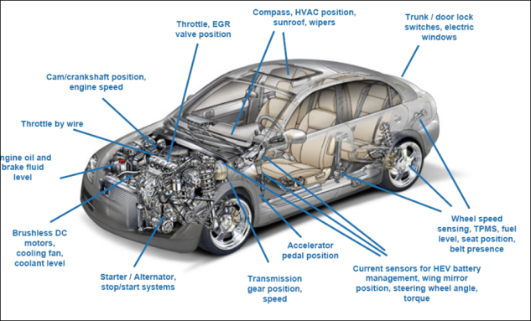
motivation
Cars are equipped with sensors since their early ages. Those sensors are used to tell the driver the current status of certain parts (breaks, oil, temperature, tires, gas level, etc.)
More developed sensors are being introduced (headlights, doors, windows Trunk, rear camera etc.)
Notes:
Here we can mention our real stories and why we came up with this idea

Slide 5
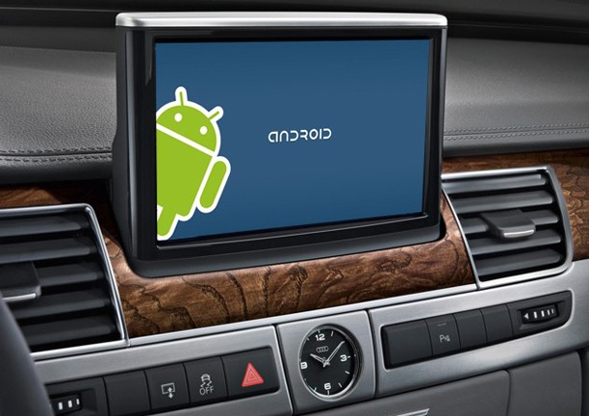
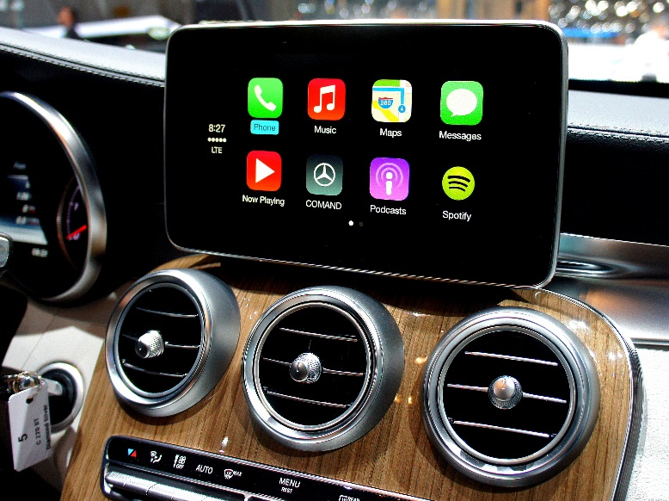
motivation
2010, “connected car” service was introduced (Wi-fi)
January 2014, Google announced the formation of the Open Automotive Alliance (OAA) and in June they Announced “Android Auto”
March 2014, Apple announced a new system to connect iPhones to car units using iOS “CarPlay”

Slide 6
Problem
Cars sensors display the current status of certain parts!
Connected cars are mostly used for automatic notification of crashes, notification of speeding and safety alerts, and entertainment
Keeping a full record of the car history and maintenance
Scheduling automatic maintenance appointments
Avoiding –future- Emergency situations!

Slide 7
Solution: Car-mate

Slide 8
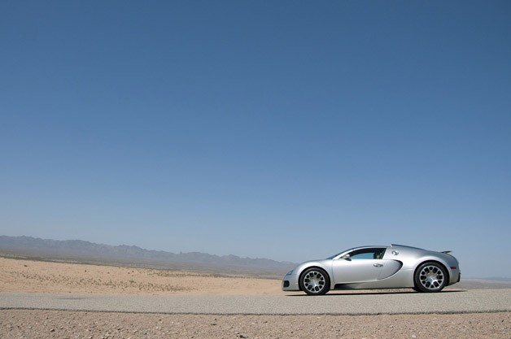


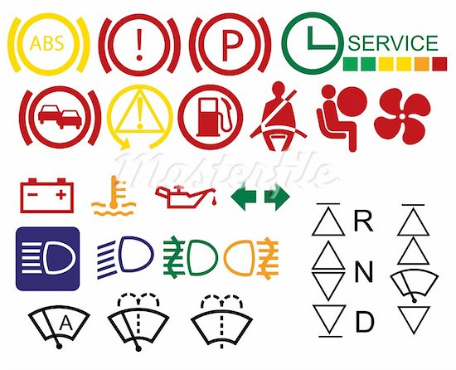
Normal
Machine learning
reports
Emergency
Sensor
data
Required maintenance
Scheduling System
Maintenance date

Slide 9
advantages
Keeping track and record of all car parts
Fixing and changing parts before total damage
Auto maintenance scheduler
Save maintenance time
Less visits to mechanics
Keeping car records when buying and selling cars
Reduce cost

Slide 10
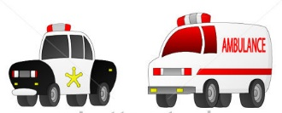
Normal
Machine learning
reports
Emergency
Sensor
data

Slide 11
advantages
Prevention is Better than Cure
Notify the driver that an emergency might happen
Show nearest station (Gas or mechanic)
Notify nearest station
Avoid damages and financial lose before happen –story-

Slide 12
Results and screenshots
Virtual Sensors are working and data is generated
Data is stored on DashDB on BlueMix
Generated data is trained and tested (off-line)
Results of classifying data using machine learning showed 98% accuracy using Naïve Bayes classifier
Demo

Slide 13
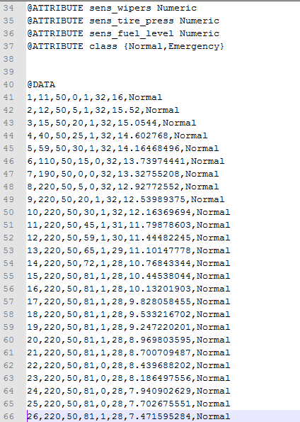
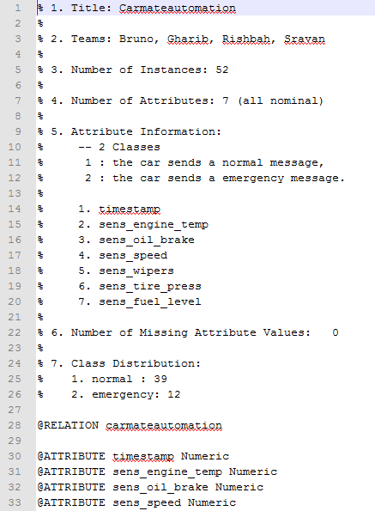

Slide 14
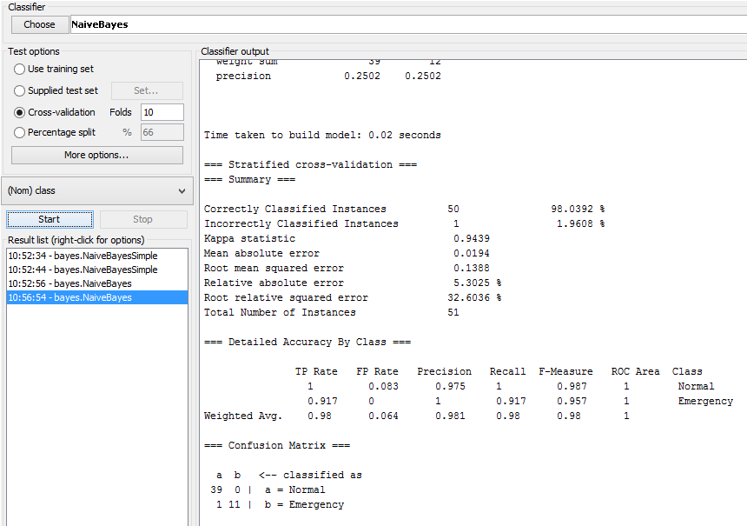

Slide 15
challenges
No background of IBM BlueMix
Some Bluemix functions –services- generated non-logical errors
Time, Time, and Time

Slide 16
Future Work
Full-working program (adding machine learning on cloud, …)
Adding GPS feature to locate nearest station
Adding Emotional Speed notifications
Tons of new possible ideas

Slide 17
One last thing

Slide 18
Twitter sentiment analysis
Modifying an existing Bluemix example to match our Course project :
“Sentiment Analysis of iphone6”
Helped us in learning the Bluemix environment
Demo

